Slide 1

#LifeKoKaroLift
Post-Graduate Diploma in ML/AI

Slide 2



Course : Machine Learning
Lecture On : Boosting - Part 2
Instructor : Manish Kumar

Slide 3
Modules Included
Quick Recap - AdaBoost
Gradient Boosting
Gradient Descent
XGBoost – (pros /cons)

Slide 4
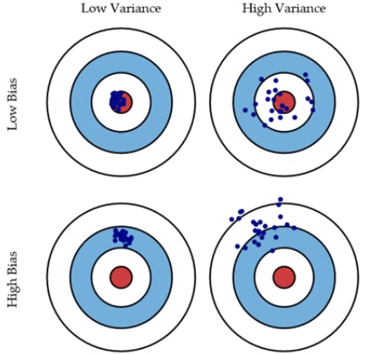
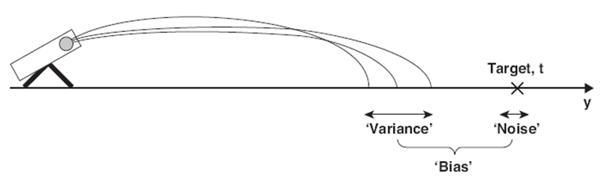
Bias and Variance in regression models
The prediction error for any machine learning algorithm can be broken down into three parts:
Bias Error
Variance Error
Irreducible Error
The irreducible error cannot be reduced regardless of what algorithm is used. It is the error introduced from the chosen framing of the problem and may be caused by factors like unknown variables that influence the mapping of the input variables to the output variable.

Slide 5
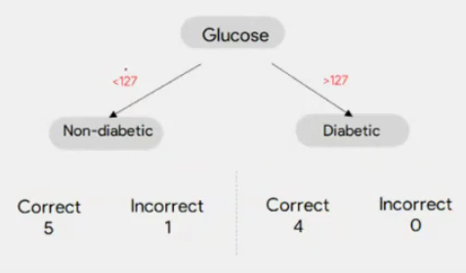
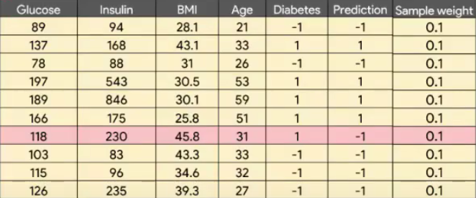
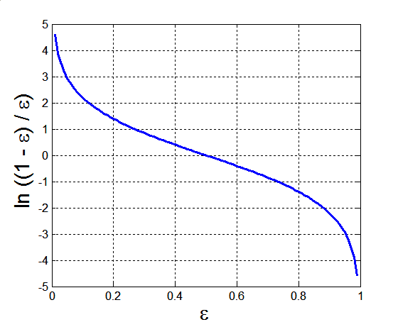
Ada Boost
The lower a classifier error rate, the more accurate it is, and therefore, the higher its weight for voting should be
Weight of a classifier C_{i}’s vote is
Error rate:
(i = index of classifier, j=index of instance)

Slide 6
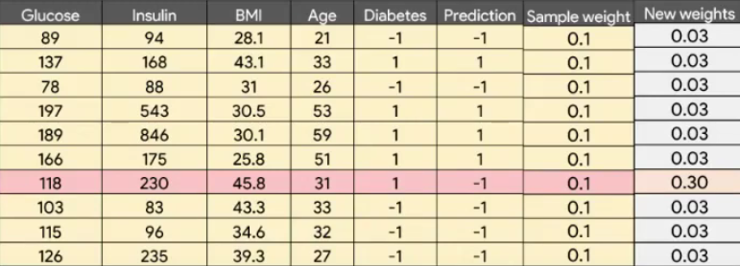
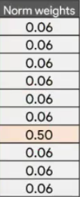
Ada Boost

Slide 7
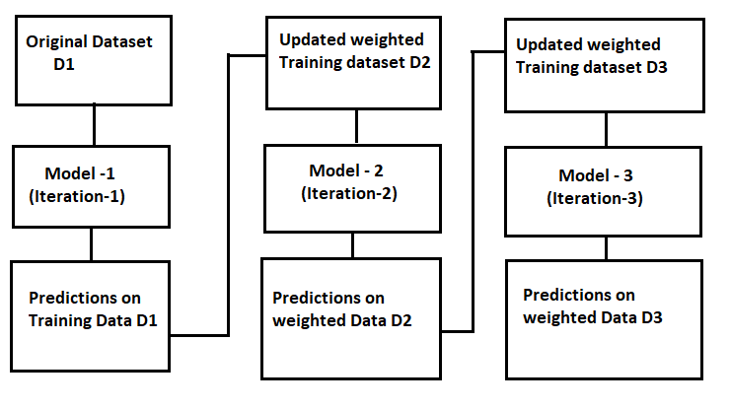
Ada Boost

Slide 8
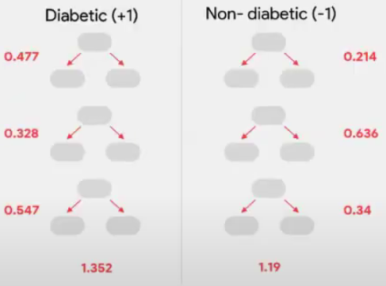
Ada Boost
Testing:
For each class c, sum the weights of each classifier that assigned class c to X (unseen data)
The class with the highest sum is the WINNER!

Slide 9


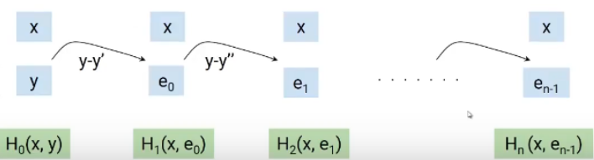
Gradient Boosting Algorithm
Like AdaBoost in GBM as well we reduce the bias of the weak learners by building models sequentially where each of the subsequent models tries to reduce the error of the previous model. But How?
Gradient boosting approaches the problem a bit differently. Instead of adjusting weights of data points, Gradient boosting focuses on the difference between the prediction and the ground truth.
M0
M1
M2
Mn
. . . . . . . .
X_train
Y_train

Slide 10

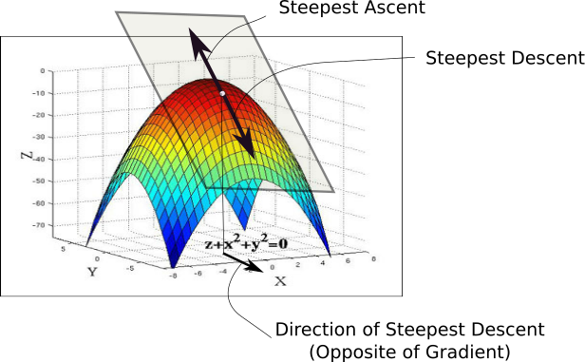
Gradient Descent
While the direction of the gradient tells us which direction has the steepest ascent, it's magnitude tells us how steep the steepest ascent/descent is. So, at the minima, where the contour is almost flat, you would expect the gradient to be almost zero. In fact, it's precisely zero for the point of minima.
Gradient descent is an optimization algorithm used to minimize some function by iteratively moving in the direction of steepest descent as defined by the negative of the gradient

Slide 11

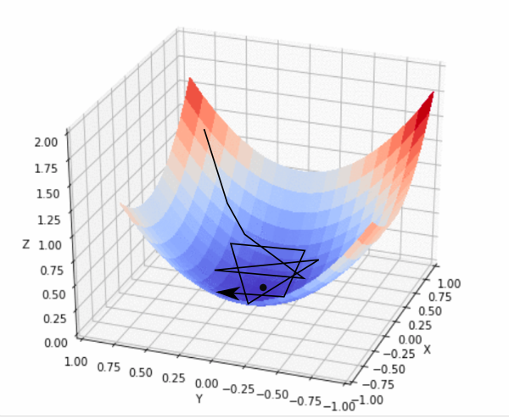
Gradient Descent
In practice, we might never exactly reach the minima, but we keep oscillating in a flat region in close vicinity of the minima. As we oscillate our this region, the loss is almost the minimum we can achieve, and doesn't change much as we just keep bouncing around the actual minimum. Often, we stop our iterations when the loss values haven't improved in a pre-decided number, say, 10, or 20 iterations. When such a thing happens, we say our training has converged, or convergence has taken place.

Slide 12
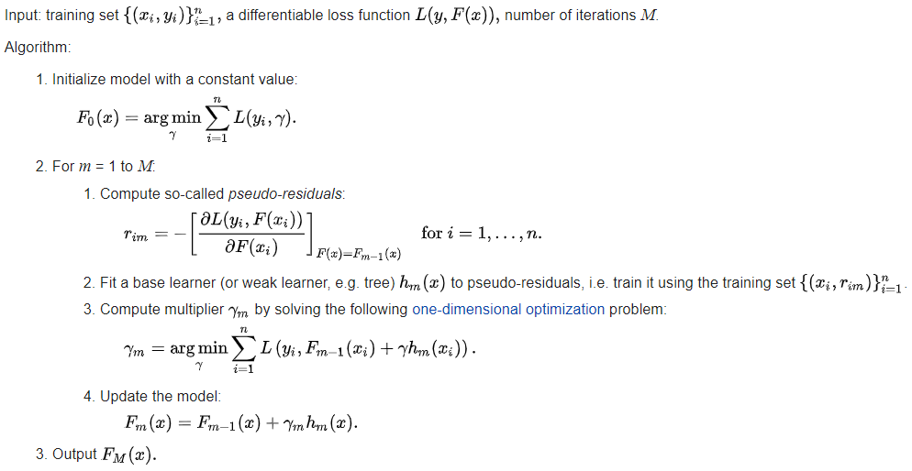

Gradient Boosting Algorithm
https://statweb.stanford.edu/~jhf/ftp/trebst.pdf

Slide 13
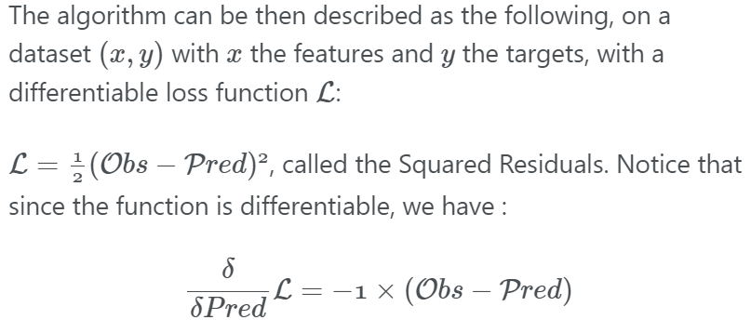

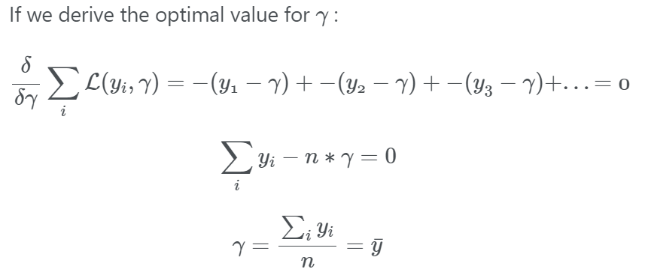
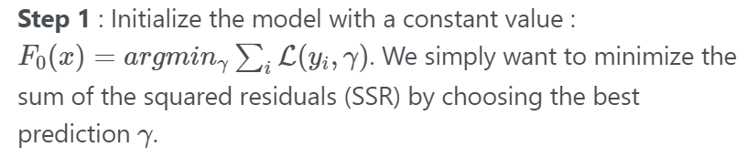
Gradient Boosting Algorithm

Slide 14
Gradient Boosting Algorithm
Area(Sq-ft) | Room(BHK) | Furnished | Rent(K) | Average(K)
480 | 2 | Y | 15 | 27.7
255 | 1 | Y | 10 | 27.7
800 | 1 | N | 35 | 27.7
785 | 2 | N | 39 | 27.7
900 | 3 | Y | 55 | 27.7
350 | 1 | Y | 12 | 27.7
Step 1 : Calculate the average of the target label
For regression, we start with a leaf that is the average value of the target variable. This leaf will be used as a baseline to approach the correct solution in the next steps.

Slide 15
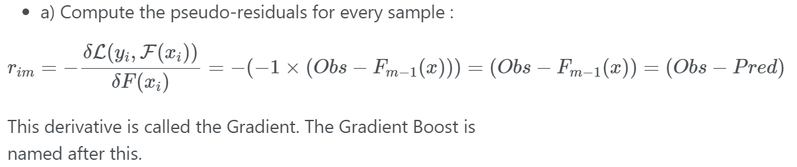
Gradient Boosting Algorithm
Step 2 : For m = 1 to M (the maximum number of trees specified, e.g 100)

Slide 16
Gradient Boosting Algorithm
Area(Sq-ft) | Room(BHK) | Furnished | Rent(K) | Average(K) | Residual
480 | 2 | Y | 15 | 27.7 | -12.7
255 | 1 | Y | 10 | 27.7 | -17.7
800 | 1 | N | 35 | 27.7 | 7.3
785 | 2 | N | 39 | 27.7 | 11.3
900 | 3 | Y | 55 | 27.7 | 27.3
350 | 1 | Y | 12 | 27.7 | -15.7
Step 2 : Calculate the residual for every sample in the dataset

Slide 17
Gradient Boosting Algorithm
Area(Sq-ft) | Room(BHK) | Furnished | Rent(K) | Average(K) | Residual
480 | 2 | Y | 15 | 27.7 | -12.7
255 | 1 | Y | 10 | 27.7 | -17.7
800 | 1 | N | 35 | 27.7 | 7.3
785 | 2 | N | 39 | 27.7 | 11.3
900 | 3 | Y | 55 | 27.7 | 27.3
350 | 1 | Y | 12 | 27.7 | -15.7
Sq footage> 500
Furnished Y/N
Room > 1
27.3K
7.3K, 11.3K
-12.7K
-17.7K,-15.7K

Slide 18
Gradient Boosting Algorithm
Area(Sq-ft) | Room(BHK) | Furnished | Rent(K) | Average(K) | Residual
480 | 2 | Y | 15 | 27.7 | -12.7
255 | 1 | Y | 10 | 27.7 | -17.7
800 | 1 | N | 35 | 27.7 | 7.3
785 | 2 | N | 39 | 27.7 | 11.3
900 | 3 | Y | 55 | 27.7 | 27.3
350 | 1 | Y | 12 | 27.7 | -15.7
Sq footage> 500
Furnished Y/N
Room > 1
27.3K
9.3K
-12.7K
-17.7K,-15.7K

Slide 19
Gradient Boosting Algorithm
Area(Sq-ft) | Room(BHK) | Furnished | Rent(K) | Average(K) | Residual | Residual
480 | 2 | Y | 15 | 27.7 | -12.7 | -12.7
255 | 1 | Y | 10 | 27.7 | -17.7 | -16.7
800 | 1 | N | 35 | 27.7 | 7.3 | 9.3
785 | 2 | N | 39 | 27.7 | 11.3 | 9.3
900 | 3 | Y | 55 | 27.7 | 27.3 | 27.3
350 | 1 | Y | 12 | 27.7 | -15.7 | -16.7
Step 3 : Construct the model on top of residuals
We will now build a model(decision tree) which is aimed at predicting residuals. In other words, every leaf will contain a prediction as to the value of the residual

Slide 20
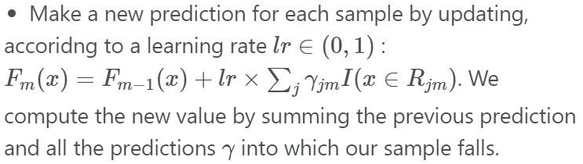
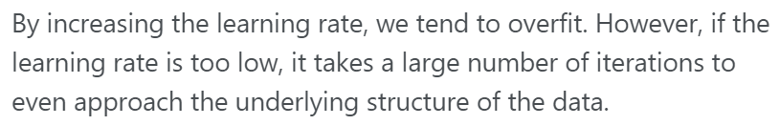
Gradient Boosting Algorithm
Area(Sq-ft) | Room(BHK) | Furnished | Rent(K) | Average(K) | Residual | Pedicted
480 | 2 | Y | 15 | 27.7 | -12.7 | 26.4
255 | 1 | Y | 10 | 27.7 | -17.7 | 26
800 | 1 | N | 35 | 27.7 | 7.3 | 28.6
785 | 2 | N | 39 | 27.7 | 11.3 | 28.6
900 | 3 | Y | 55 | 27.7 | 27.3 | 30.4
350 | 1 | Y | 12 | 27.7 | -15.7 | 26
Step 4 : Compute the predictions
27.7K(Average rent) + 0.1(LR)(Residual of the sample) = New Prediction
27.7 +0.1*(-12.7) = 26.4

Slide 21
Gradient Boosting Algorithm
Area(Sq-ft) | Room(BHK) | Furnished | Rent(K) | Average(K) | Residual | Pedicted | New-Residual
480 | 2 | Y | 15 | 27.7 | -12.7 | 26.4 | -11.4
255 | 1 | Y | 10 | 27.7 | -17.7 | 26 | -16
800 | 1 | N | 35 | 27.7 | 7.3 | 28.6 | 6.4
785 | 2 | N | 39 | 27.7 | 11.3 | 28.6 | 10.4
900 | 3 | Y | 55 | 27.7 | 27.3 | 30.4 | 24.6
350 | 1 | Y | 12 | 27.7 | -15.7 | 26 | -14
Step 5 : Compute the new residuals
New residuals of the sample = Actual rent – predicted rent

Slide 22
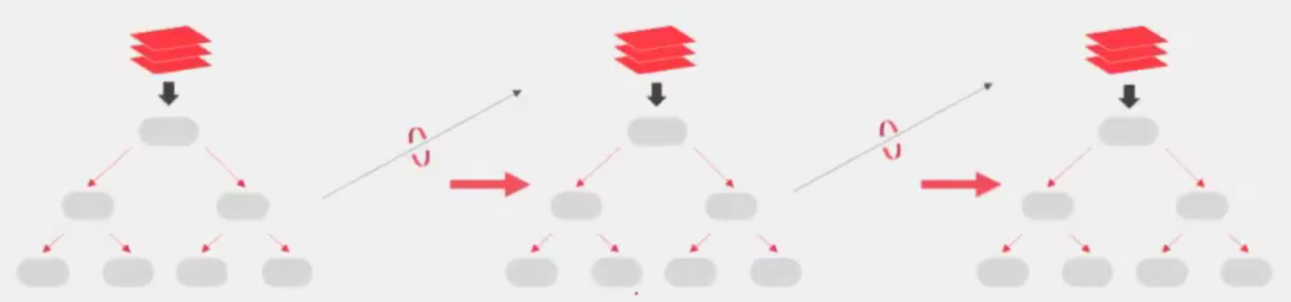
Gradient Boosting Algorithm
Prediction : Use all of the trees in the ensemble to make a final prediction
27.7K + 0.1*(-12.7) + 0.1*(-11.4) + …

Slide 23
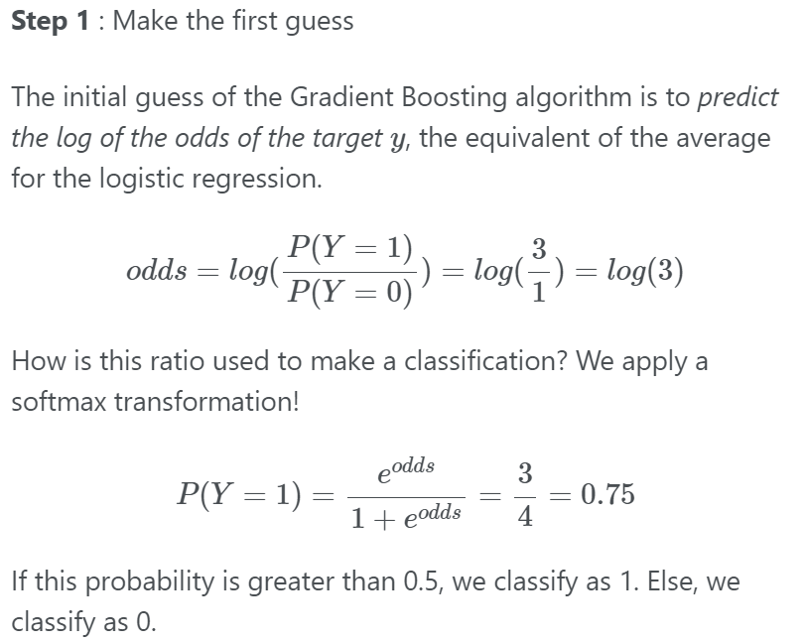
Gradient Boosting Algorithm - Classification

Slide 24
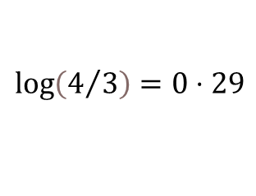
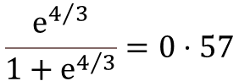
Gradient Boosting Algorithm
Age | Sex | Pclass | Survived | Initial Pred
22 | M | 3 | 0 | 0.57
38 | F | 1 | 1 | 0.57
26 | F | 1 | 1 | 0.57
35 | F | 1 | 1 | 0.57
54 | M | 3 | 0 | 0.57
2 | M | 3 | 1 | 0.57
43 | M | 3 | 0 | 0.57
Step 1 : Calculate the initial Prediction for every individual -> log(odds)
We can’t use the value directly, since it needs to be converted to a probability value. To do so, we will use the logistic function to transform it to a probability.
$$\log\left(4/3\right)=0⋅29$$
$$\frac{ⅇ^{4/3}}{1+ⅇ^{4/3}}=0⋅57$$
Probability of surviving

Slide 25
Gradient Boosting Algorithm
Age | Sex | Pclass | Survived | Initial Pred | Residual
22 | M | 3 | 0 | 0.57 | -0.57
38 | F | 1 | 1 | 0.57 | 0.43
26 | F | 1 | 1 | 0.57 | 0.43
35 | F | 1 | 1 | 0.57 | 0.43
54 | M | 3 | 0 | 0.57 | -0.57
2 | M | 3 | 1 | 0.57 | 0.43
43 | M | 3 | 0 | 0.57 | -0.57
Step 2 : Calculate the pseudo-residual for every sample dataset

Slide 26
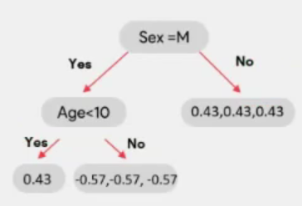
Gradient Boosting Algorithm
Age | Sex | Pclass | Survived | Initial Pred | Residual
22 | M | 3 | 0 | 0.57 | -0.57
38 | F | 1 | 1 | 0.57 | 0.43
26 | F | 1 | 1 | 0.57 | 0.43
35 | F | 1 | 1 | 0.57 | 0.43
54 | M | 3 | 0 | 0.57 | -0.57
2 | M | 3 | 1 | 0.57 | 0.43
43 | M | 3 | 0 | 0.57 | -0.57
Step 3 : Construct the model on top of residuals
We will now build a model(decision tree) which is aimed at predicting residuals. In other words, every leaf will contain a prediction as to the value of the residual

Slide 27
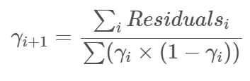
Gradient Boosting Algorithm
Age | Sex | Pclass | Survived | Initial Pred | Residual
22 | M | 3 | 0 | 0.57 | -0.57
38 | F | 1 | 1 | 0.57 | 0.43
26 | F | 1 | 1 | 0.57 | 0.43
35 | F | 1 | 1 | 0.57 | 0.43
54 | M | 3 | 0 | 0.57 | -0.57
2 | M | 3 | 1 | 0.57 | 0.43
43 | M | 3 | 0 | 0.57 | -0.57
Step 3 : Construct the model on top of residuals

Slide 28
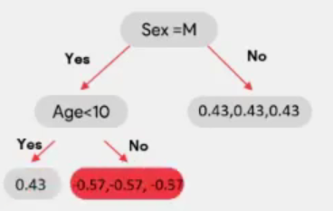
Gradient Boosting Algorithm
Age | Sex | Pclass | Survived | Initial Pred | Residual
22 | M | 3 | 0 | 0.57 | -0.57
38 | F | 1 | 1 | 0.57 | 0.43
26 | F | 1 | 1 | 0.57 | 0.43
35 | F | 1 | 1 | 0.57 | 0.43
54 | M | 3 | 0 | 0.57 | -0.57
2 | M | 3 | 1 | 0.57 | 0.43
43 | M | 3 | 0 | 0.57 | -0.57
Step 3 : Construct the model on top of residuals
$$\frac{−0⋅57−0⋅57−0⋅57}{0⋅57\left(1−0⋅57\right)+0.57\left(1−0⋅57\right)+0⋅57\left(1−0⋅57\right)}=−2.3$$

Slide 29
Gradient Boosting Algorithm
Age | Sex | Pclass | Survived | Initial Pred | Residual | Leaf Output | New log Odds
22 | M | 3 | 0 | 0.57 | -0.57 | -2.3 | -1.09
38 | F | 1 | 1 | 0.57 | 0.43 | 1.75 | 1.34
26 | F | 1 | 1 | 0.57 | 0.43 | 1.75 | 1.34
35 | F | 1 | 1 | 0.57 | 0.43 | 1.75 | 1.34
54 | M | 3 | 0 | 0.57 | -0.57 | -2.3 | -1.09
2 | M | 3 | 1 | 0.57 | 0.43 | 1.75 | 1.34
43 | M | 3 | 0 | 0.57 | -0.57 | -2.3 | -1.09
Step 4 : Compute the predictions
New log(odds) = initial log(odds) + LR(Output value by D.T) -> log(4/3) = 0.29
New log(odds) = 2.9 +0.6(-2.3) = -1.09
New log(odds) = 0.29+0.6(1.75) = 1.34

Slide 30
Gradient Boosting Algorithm
Age | Sex | Pclass | Survived | Initial Pred | Residual | Leaf Output | New log Odds | New Pred | New Residual
22 | M | 3 | 0 | 0.57 | -0.57 | -2.3 | -1.09 | 0.25 | -0.25
38 | F | 1 | 1 | 0.57 | 0.43 | 1.75 | 1.34 | 0.8 | 0.2
26 | F | 1 | 1 | 0.57 | 0.43 | 1.75 | 1.34 | 0.8 | 0.2
35 | F | 1 | 1 | 0.57 | 0.43 | 1.75 | 1.34 | 0.8 | 0.2
54 | M | 3 | 0 | 0.57 | -0.57 | -2.3 | -1.09 | 0.25 | -0.25
2 | M | 3 | 1 | 0.57 | 0.43 | 1.75 | 1.34 | 0.8 | 0.2
43 | M | 3 | 0 | 0.57 | -0.57 | -2.3 | -1.09 | 0.25 | -0.25
Step 5 : Build another tree on top of this residual

Slide 31
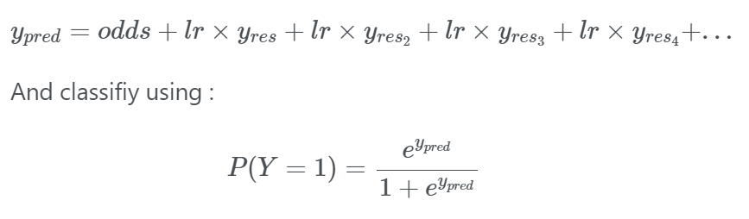
Gradient Boosting Algorithm
Age | Sex | Pclass | Survived | Initial Pred | Residual | Leaf Output | New log Odds | New Pred | New Residual
22 | M | 3 | 0 | 0.57 | -0.57 | -2.3 | -1.09 | 0.25 | -0.25
38 | F | 1 | 1 | 0.57 | 0.43 | 1.75 | 1.34 | 0.8 | 0.2
26 | F | 1 | 1 | 0.57 | 0.43 | 1.75 | 1.34 | 0.8 | 0.2
35 | F | 1 | 1 | 0.57 | 0.43 | 1.75 | 1.34 | 0.8 | 0.2
54 | M | 3 | 0 | 0.57 | -0.57 | -2.3 | -1.09 | 0.25 | -0.25
2 | M | 3 | 1 | 0.57 | 0.43 | 1.75 | 1.34 | 0.8 | 0.2
43 | M | 3 | 0 | 0.57 | -0.57 | -2.3 | -1.09 | 0.25 | -0.25

Slide 32
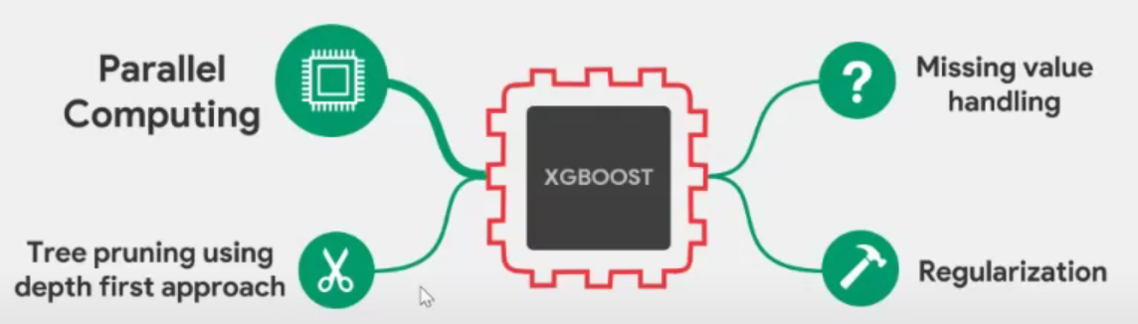
XGBOOST

Slide 33

#LifeKoKaroLift
Thank You!

